Slide 1
Abstracting to Design Patterns
Computer Science and Software Engineering
© 2014 Project Lead The Way, Inc.

Slide 2
How Do We Abstract?
Remove details
Generalize
Helps us handle complexity
What Makes It Easy to Reuse Code?
Conceal details
Separate concerns
Helps us handle complexity
Very Similar!
Notes:
Abstraction is related to reusing code.
Something that has been abstracted applies to more general circumstances.
There are techniques in addition to abstraction that help us write code that can be reused more easily.
Try to write short pieces of code grouped into a procedure, function, or method (corresponding to the programming paradigms of imperative, functional, and object-oriented programming).
Break it into small pieces.
Separate concerns when you can. For example, if the ShoppingCart keeps track of what the user hopes to buy, don’t also make it be the CashRegister. Let separate classes deal with separate concerns.
Small pieces are easier to reuse. They’re also easier to debug and maintain.

Slide 3
Refactoring
Break up long stretch of code
Unify duplicates
Reread and improve your own documentation
High level documentation
Block comments and doc strings
In-line comments
Notes:
“Refactoring” is a routine part of a programmer’s job. Refactoring includes:
Breaking up large stretches of code into smaller functions.
Pushing duplicate code into one more generalized function where it can be reused. Improving documentation also helps make code reusable and easier to maintain.
In industry, a lot more time is spent reading a piece of code than was spent writing it in the first place. Professionals have learned the hard way that we need to create great documentation for our code. That includes docstrings and comments about sections of code, in-line comments, and high-level documentation for the whole program. Developing good habits earlier in your career will make you more valuable later.
The easiest time to document code is while it is fresh in your mind. Five minutes spent documenting now will achieve more than any five minutes spent on it down the road.

Slide 4
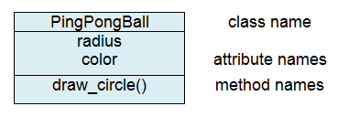
Uniform Markup Language
Notes:
Recall that UML documents classes at a high level.

Slide 5
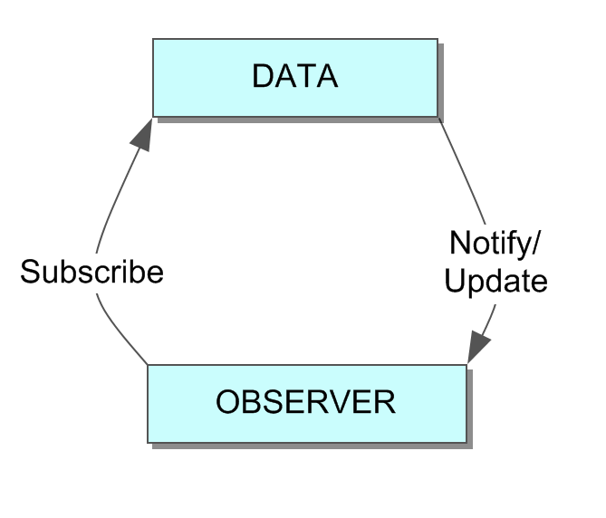
Design Patterns: Observer
Relationships among classes
Notes:
Putting together several classes in a diagram can show how the classes are related. These relationships show up over and over in different contexts. It’s a whole new layer of abstraction: design patterns. A design pattern is a general solution that coders repeatedly find useful. This slide shows the observer pattern. The computer has some data, and one or more observers use the data without being able to change it. Various classes might fulfill the data role in the pattern. Similarly, there might be many classes of observers.

Slide 6
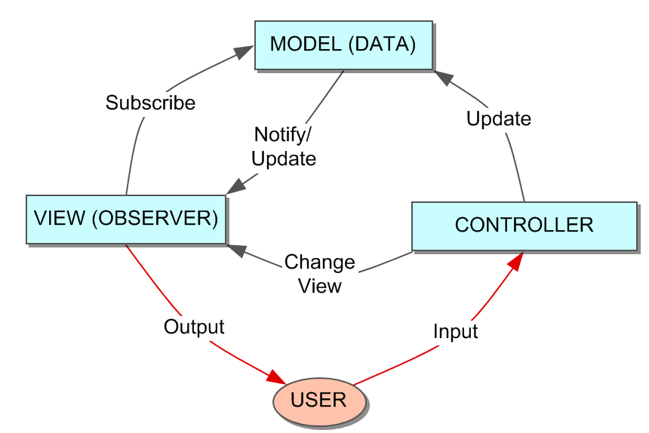
Design Patterns: Model-View-Controller
Relationships among classes
Notes:
Some GUIs follow the data-observer pattern, but they also allow the user to control the data and to control how the observer is looking at the data. We call this the MVC pattern.

Slide 7
Design Patterns: Model-View-Controller
Model: The data
View: How the user sees the data
Controller: User can affect data or view
Notes:
The model-view-controller pattern separates the concerns of the program into three categories. The model holds the data. Each view looks at the data. Views register with the model, subscribing to updates. The controller classes allow the user to update the model and also allow the user to change the view. Consider a web page. The page contains the model. The browser shows you a view of the data. By scrolling, zooming in, etc., you can control the view. The browser doesn’t let you change the model, but it definitely fits the MVC pattern.

Slide 8
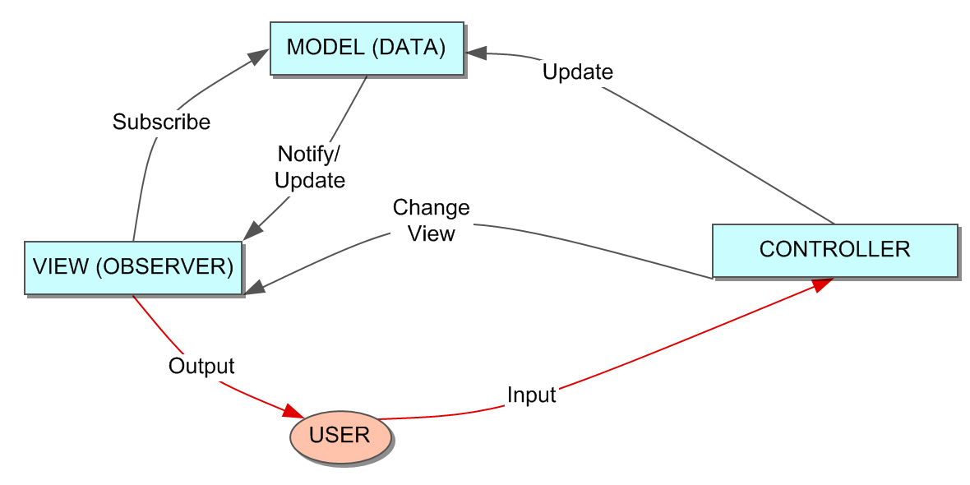
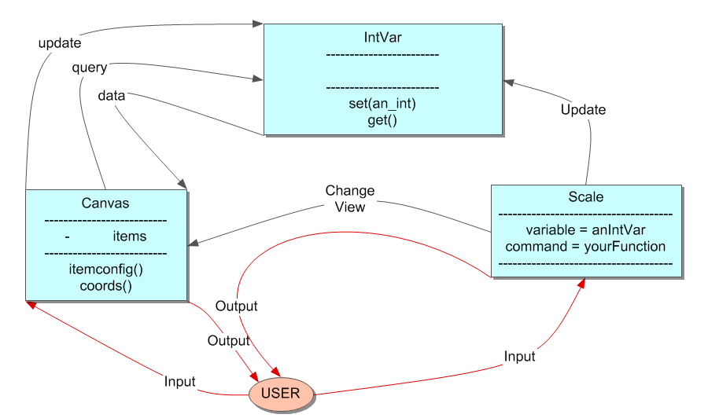
Tkinter Pattern
Notes:
Tkinter makes it easy to follow a pattern similar to the MVC pattern. The widgets are generally used as a View or a Controller. The four TkVariables classes (IntVar, etc.) are data: the Model. A Canvas views the items. A Scale controls some data.
Tkinter takes care of some of the connections among the model, view, and controller layers. When you move the slider (a control) its IntVar ( a model) is automatically updated, and the screen displays the new value (a view).
Note: Some things aren’t quite the MVC pattern. The canvas (a view) holds onto data about its items (the model). If the controller wants to change those data, the controller has to ask the canvas (a view) to do it. Not a big deal, and a perfectly reasonable way for Tkinter to be coded. But it’s not MVC. Still, MVC is a useful way to think about software. And separating concerns along MVC lines will often improve your Tkinter code and help you think clearly about what components are doing what jobs.
Another fine point to notice in this figure is the difference between the subscribe/notify exchange of the model and the view, and the query/data exchange of the IntVar and the Canvas. In subscribe/notify, the view registers with the model, asking to be notified if there are any updates later. In Tkinter, this is possible (with a trace() method) but the view can also query the model, and the model responds with the current data. This is the get() method of the Tk variables. If the model changes, the view will be unaware of the change until it makes a fresh query on the model.

Slide 9
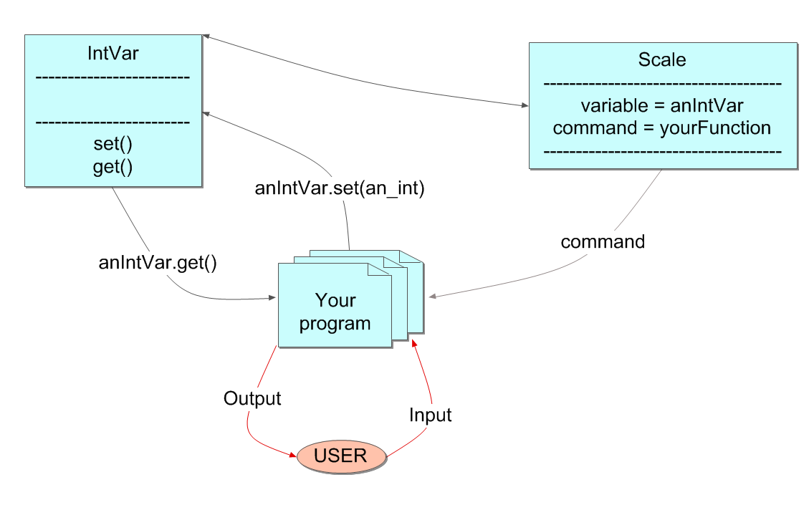
Tkinter Pattern
Notes:
Ultimately, you will use two methods and two arguments to stitch together the model, view, and controllers in Tkinter.
get() and set() are called on TkVariables.
Widget constructors have command arguments. You write a function and then give that function name as the argument to Widget(command=).
Widget constructors also have a variable argument. You instantiate a TkVariable and then give that object name as the argument to Widget(variable=)

Slide 10
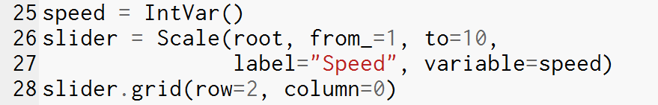

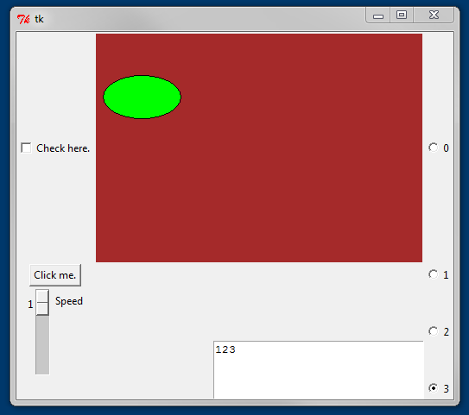

The Widget’s Variable Argument
Holds a Python variable type but connects to other layers in the design pattern
Notes:
The variable argument connects the controller to the model.

Slide 11
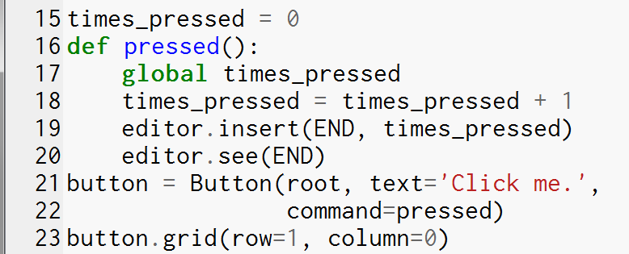
The Widget’s Command Argument
Specifies a handler
Notes:
The command argument connects the widget to a function that you define. Each class of widgets has one kind of widget event. For a button, the event occurs when the button is released.

Slide 12
The Widget’s bind() Method
Specifies an event and a handler
Necessary if you want a widget to respond to events other than its standard event
Notes:
For a Scale, the standard widget event is that the scale is dragged by the user. The event that occurs when the user first clicks on the Scale’s handle but has not yet moved: what about that event? What if we want something to happen when that event occurs? For this, we can use the widget bind() method.

